Slide 1

ENGINEERING EXPLORATION(20ME03)
PROJECT SEMINAR
ON
E-SCHOOL MANAGEMENT SYSTEM
Aarthi - 160120737001
Akshita - 160120737002
Harini - 160120737003
Krishna - 160120737004
Manasa - 160120737005
Branch: IT-1
Mentor: I.Sucharitha , Assistant Professor

Slide 2
CONTENTS
1. Abstract
2. Introduction
3. Problem Statement
4. System Design
5. Implementation
6. Results
7. Conclusion
8. Future Scope

Slide 3
ABSTRACT
An E-School Management System is an information management system for educational institutions to manage all students and teachers data.
The E-school management system will manage all the work in any school in particular order so that the time requirement and complexity of the system will be reduced.
The main objective of E-school management system is to computerize the paperwork in the system and automate the work.
E-School management system has been designed with features that make it possible for students to view their attendance records, grade checks, report cards and fee details in just a few clicks.

Slide 4
INTRODUCTION
E-School is a complete school information management solution. Today's schools need to manage more information than ever before.
E-School automates various activities of school and optimizes the use of premium resources. Concerned authorities can now easily and seamlessly use the system to access student details, otherwise a time consuming and tedious task.
School Management Software offers a strong backbone to the education system. It integrates information from various areas and brings them under one roof. This reduces the hassle involved in performing the task.

Slide 5
PROBLEM STATEMENT
To design a system that that helps students chec

Slide 6
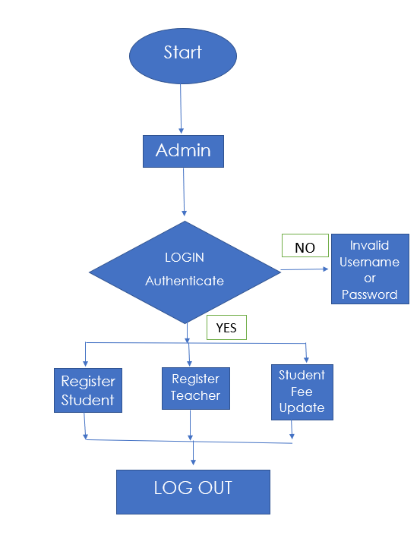
SYSTEM DESIGN
STEP 1:
Fig 4.1:Admin flow chart

Slide 7
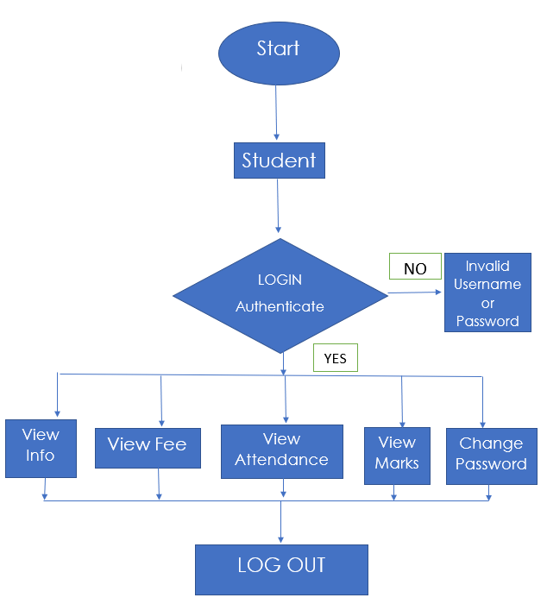
STEP 2:
Fig 4.2:Student flow chart

Slide 8
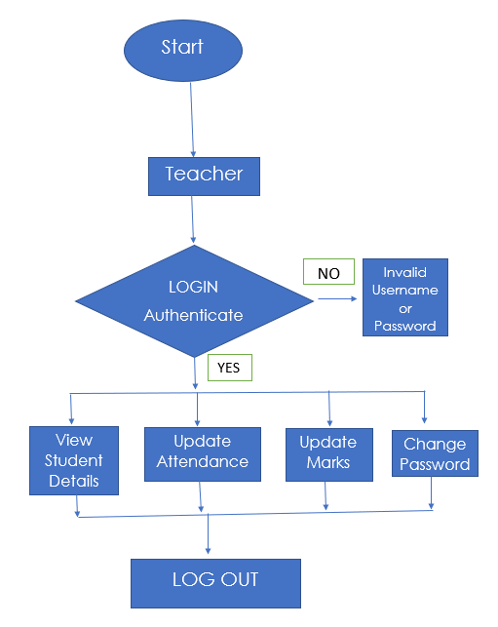
STEP 3:
Fig 4.3:Teacher flow chart

Slide 9
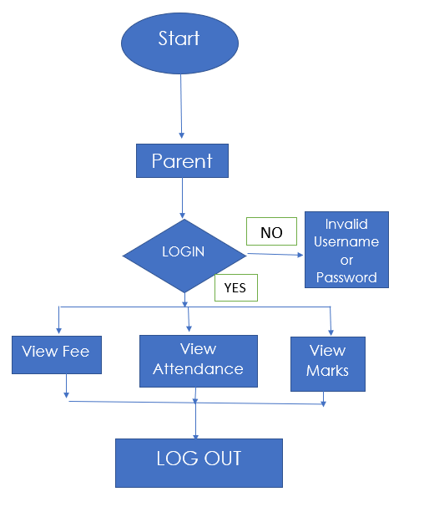
STEP 4:
Fig 4.4:Parent flow chart

Slide 10
IMPLEMENTATION
There are four main users for this system; these are Admin, student, teacher and the parent. Each user can perform several different functions during the use of the system.
Users have their respective usernames and passwords using which they can login.
LOG-IN:
This will help users to login into the system using institute id and password. A user who has the valid id and password can only log in to their respective accounts.
It will help the authentication of the user who enters the system. The module provides a layer of security over the system as only authorized personnel can login into the system . This prevents any anonymous person to enter the system and mishandle the records. It is better than the manual method as they do not have any security measure of who can access the system and who cannot.

Slide 11
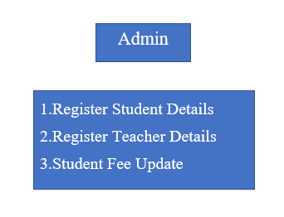
The admin can register student details , teacher details and update the fee status as per the fee payment.
The admin will register the student as the student is new in the educational institute. It will be formed like a structure where all the their details such as full name , class , mobile number , student password will be filled.

Slide 12
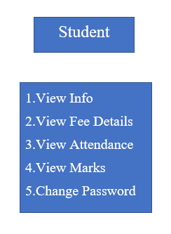
The student can view their personal details, view fee status, view attendance , view marks and change password.
Change password is available only for students of grade 10 and above.
Their attendance and marks/results can be viewed with respect to their subjects . The students can also change their password by entering the password initially given by the admin.

Slide 13
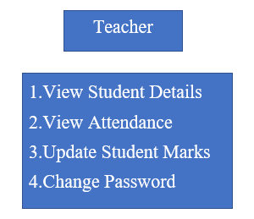
The teacher can view students details, update student’s attendance for the respective subject , update student marks, and change password .
The teacher can view a particular student details by entering the student ID number . They can also view the details of the entire class by entering the class Number.
The teacher can also change their password by entering the password initially given by the admin.

Slide 14
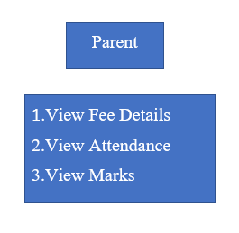
The parents can login to the system by giving their ward’s ID and mobile number . As shown, the parent can view fee status, attendance and marks of their ward.
The student’s attendance and marks/results can be viewed with respect to their subjects .

Slide 15
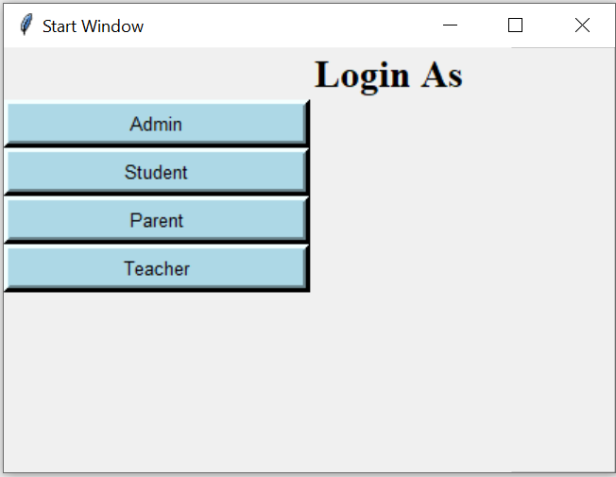
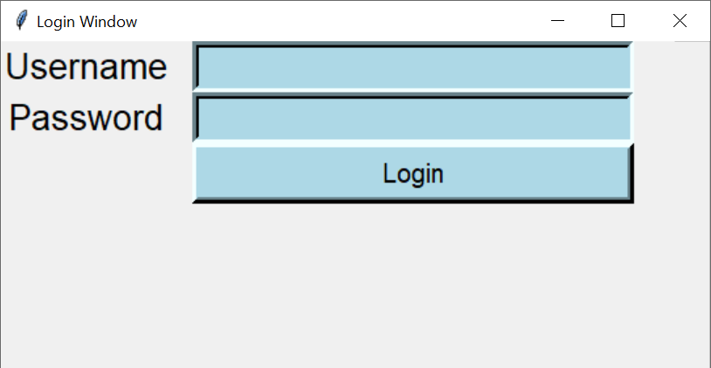
RESULTS
LOGIN: It is a multi-user login Interface where you can login as Admin , Student , Parent , Teacher . User can login by giving the username and password.
Fig 6.1:Log in As window
Fig 6.2:login window

Slide 16
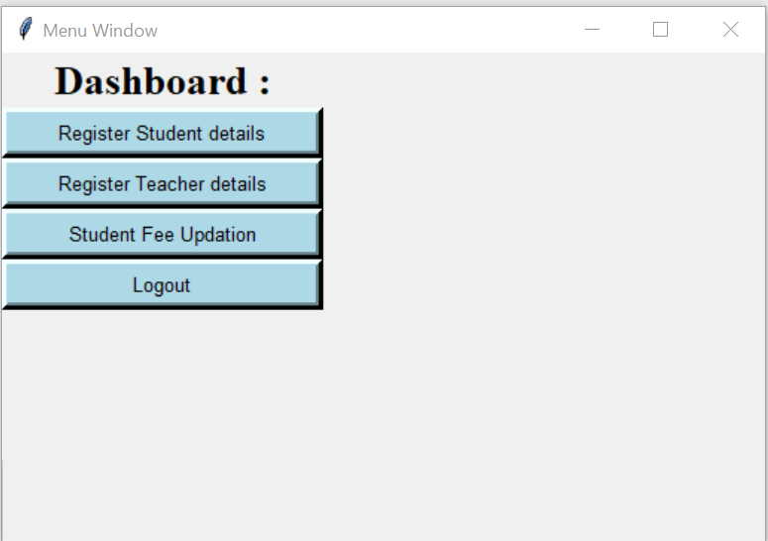
ADMIN MENU WINDOW:
Fig 6.3:Dashboard of Admin

Slide 17
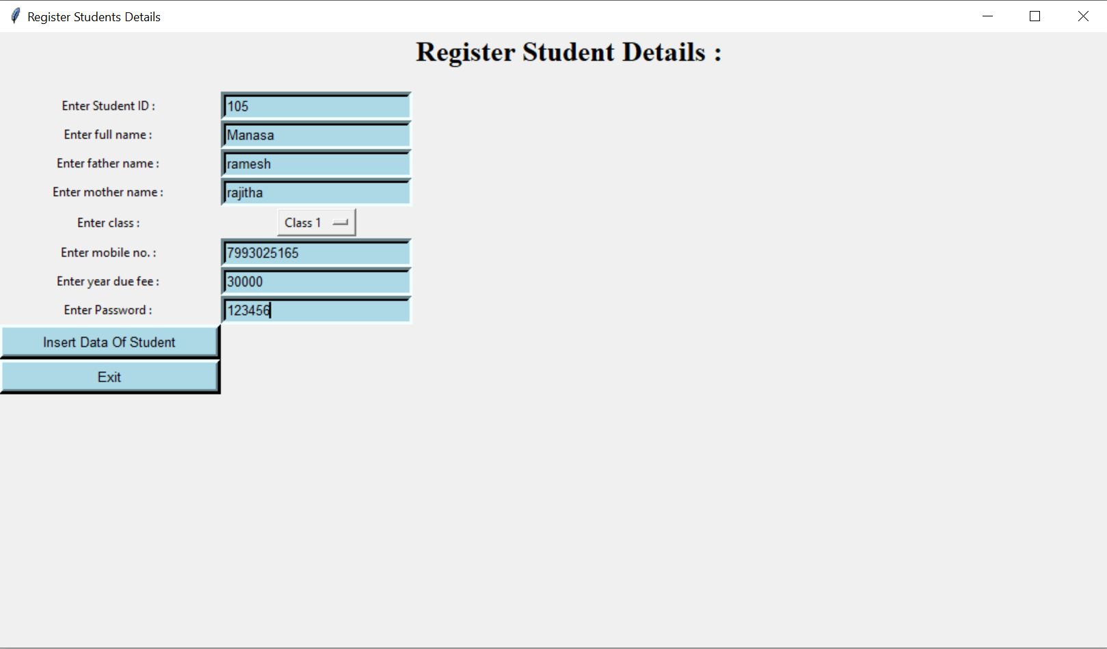
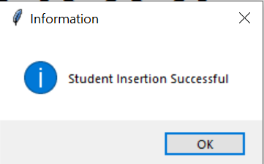
ADMIN: Register Student Details
Fig 6.5:message of successful insertion
Fig 6.4:admin registering student details

Slide 18
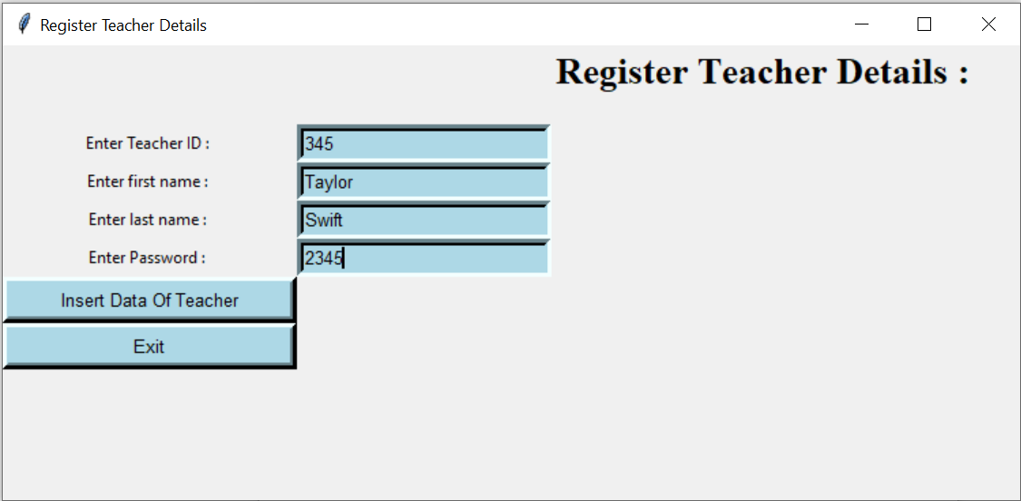
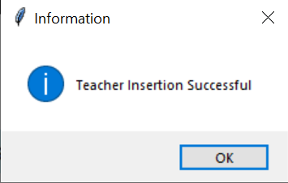
ADMIN: Register Teacher Details
Fig 6.7:message of successful insertion
Fig 6.6:Admin registering teacher details

Slide 19
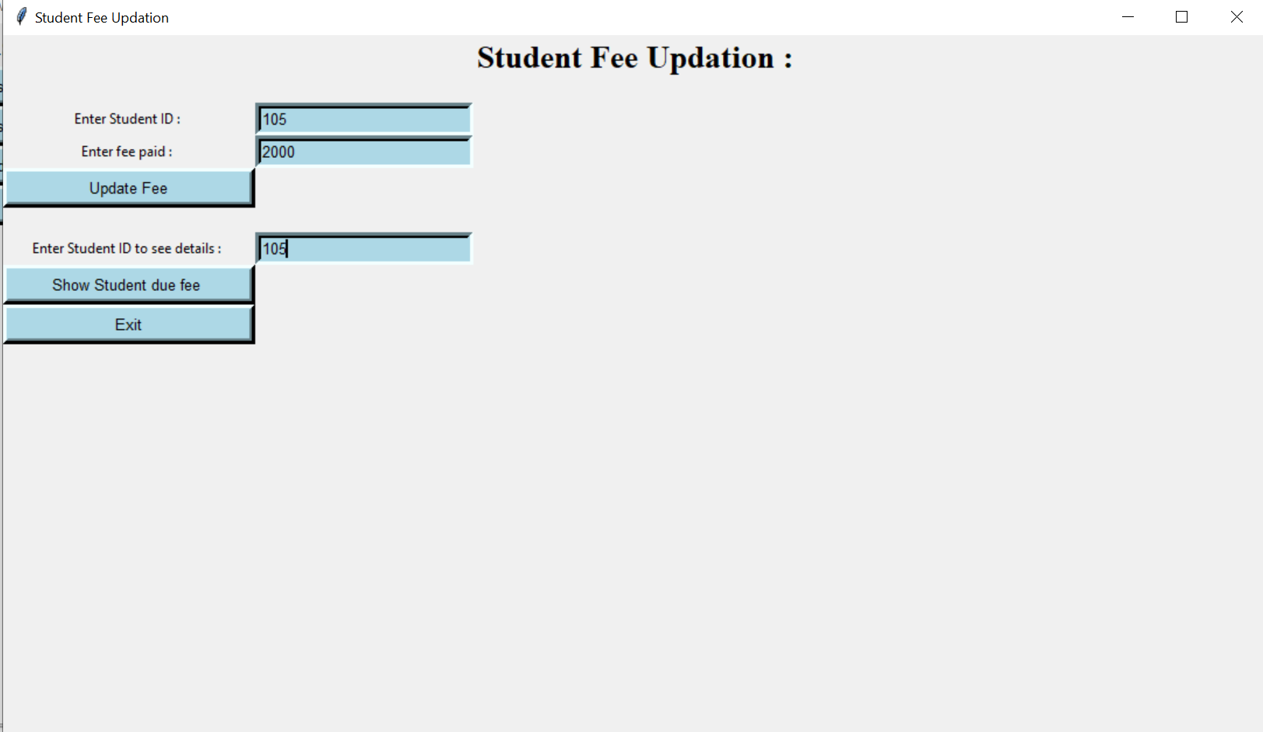
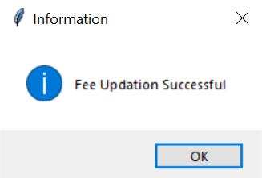
ADMIN: Student fee Update
Fig 6.9:message of successful updation
Fig 6.8:Admin updating student fee

Slide 20

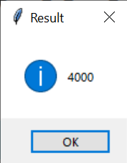
Fig 6.11:displaying fee
Fig 6.10:viewing student fee

Slide 21
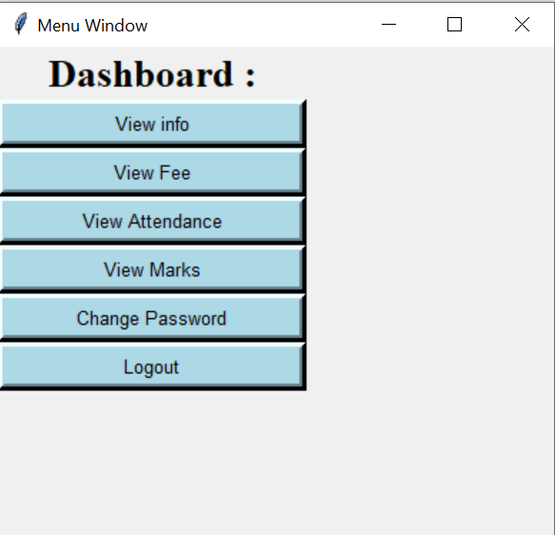
STUDENT MENU WINDOW:
Fig 6.12:Student Dashboard

Slide 22
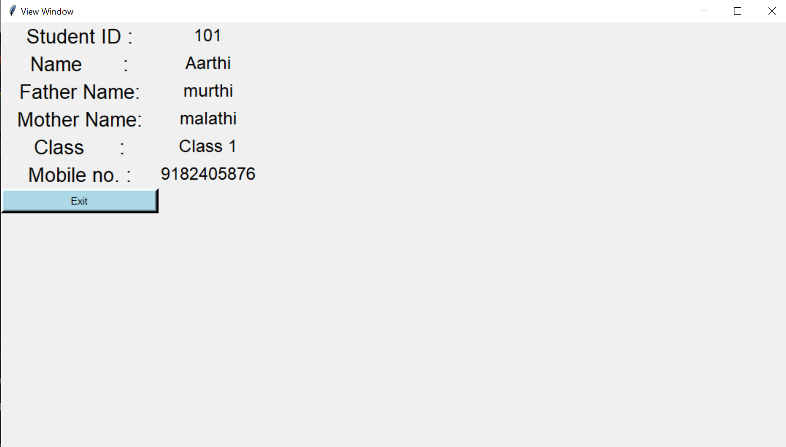
STUDENT: View info
Fig 6.13:Student viewing personal info

Slide 23
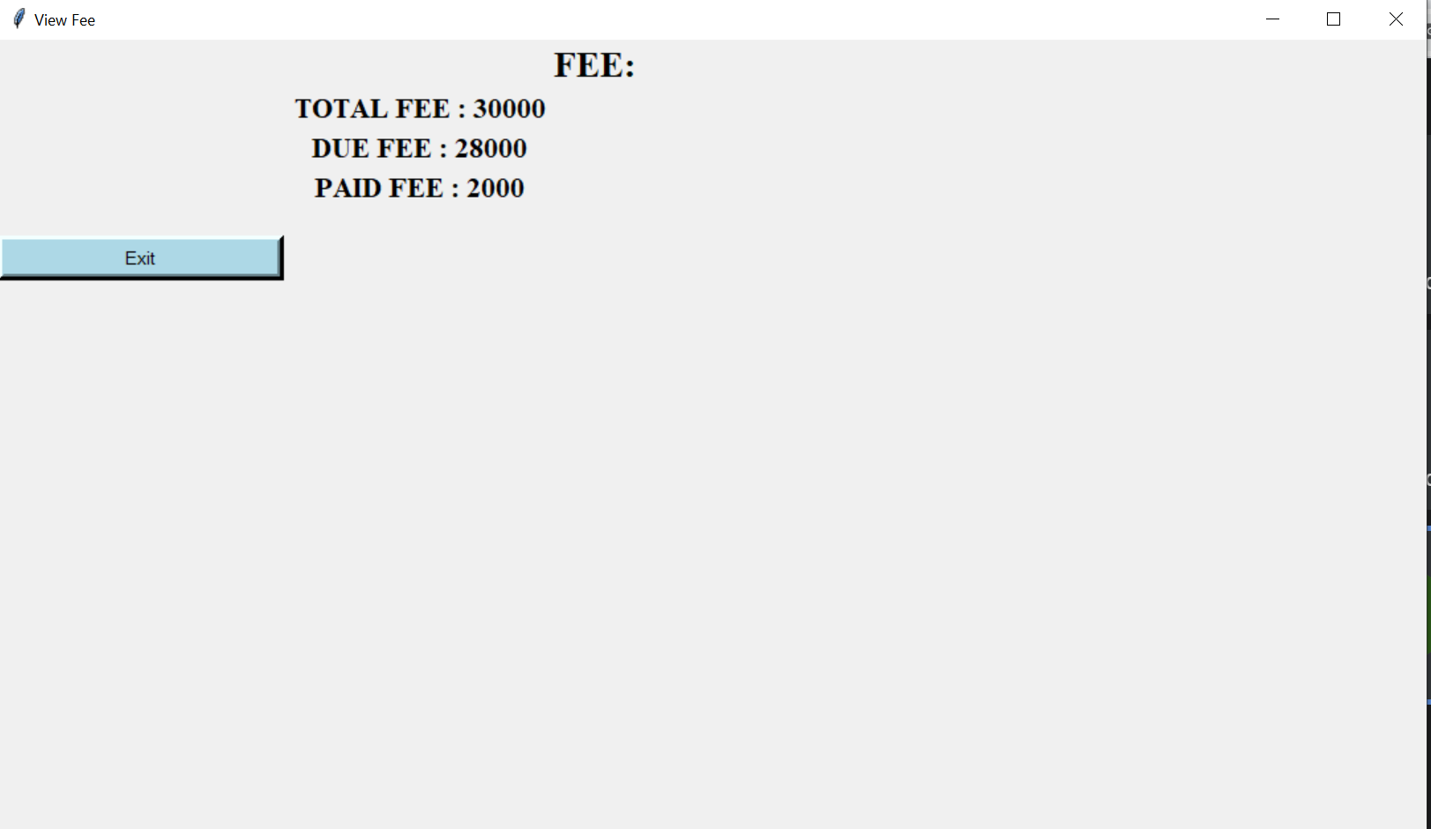
STUDENT: View Fee Details
Fig 6.14:Viewing fee details

Slide 24
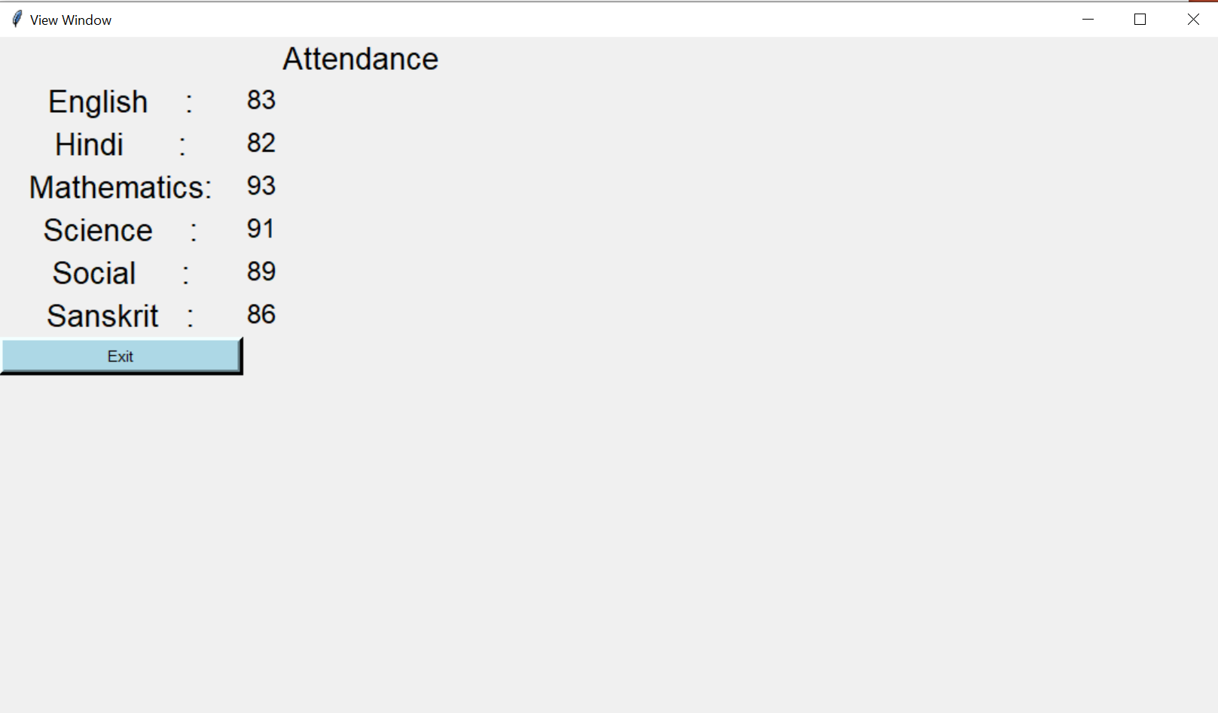
STUDENT: View Attendance
Fig 6.15:Student viewing attendance

Slide 25
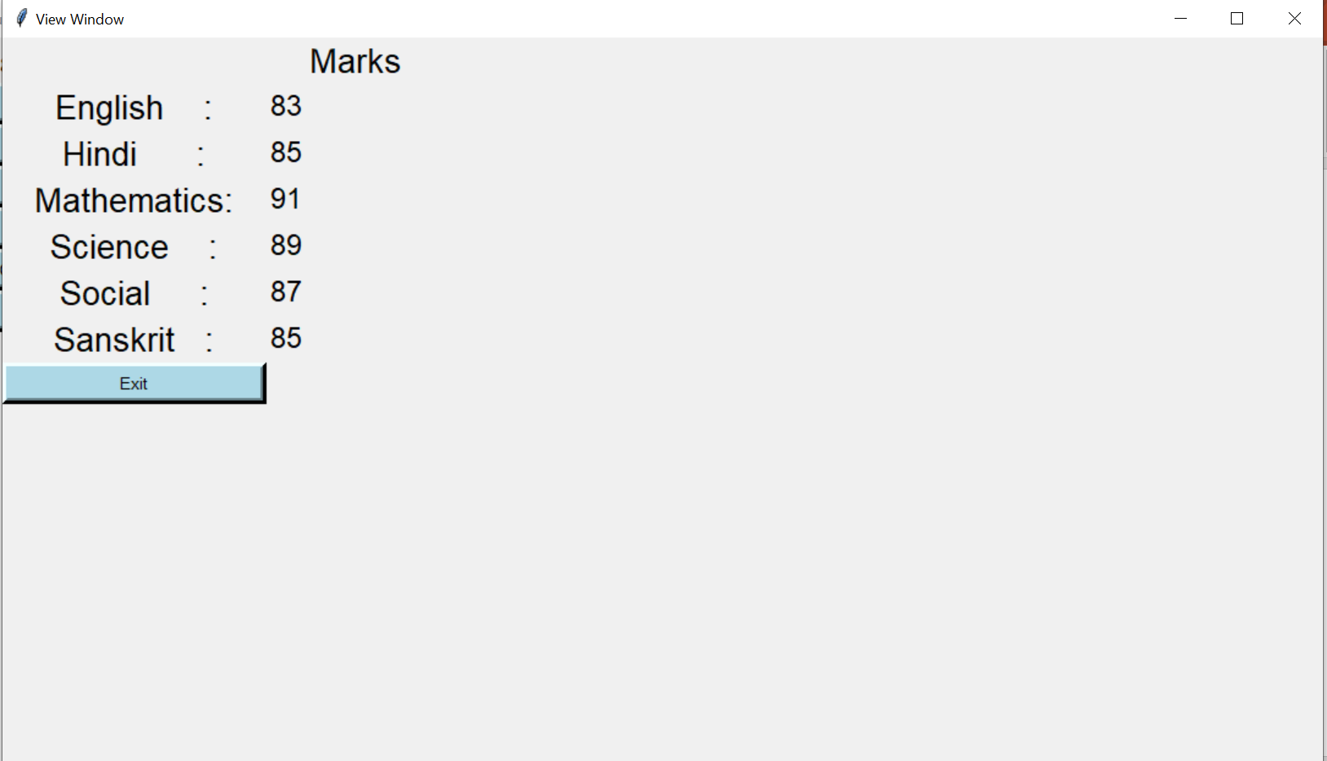
STUDENT: View Marks
Fig 6.16:Student viewing marks

Slide 26
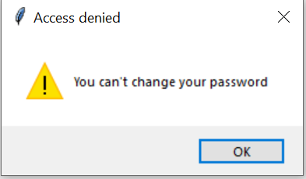
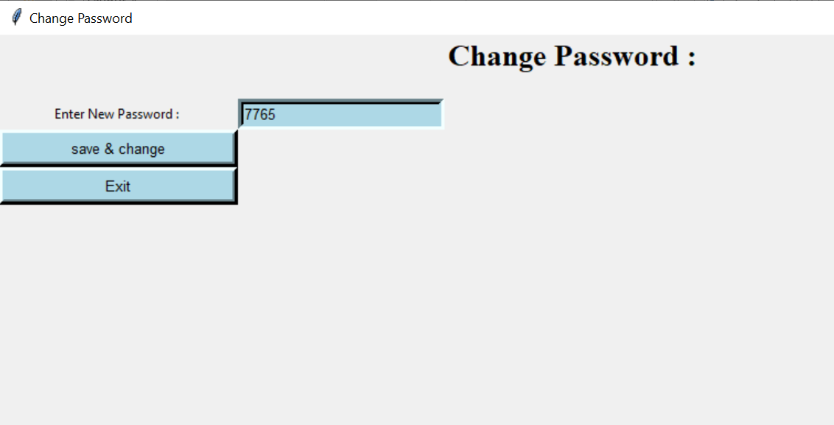
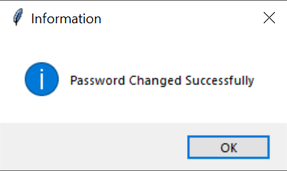
STUDENT: Change Password
For Class 1 to 10:
Fig 6.17:access denying message
For class 11 and 12:
Fig 6.19:message of successful changing password
Fig 6.18:Changing password

Slide 27
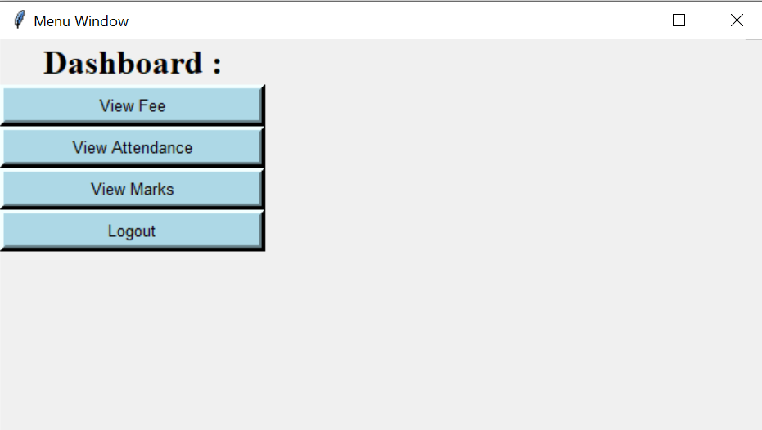
PARENT MENU WINDOW:
Fig 6.20:Parent dashboard window

Slide 28
PARENT: View Fee Status
Fig 6.21:Viewing fee details

Slide 29
PARENT: View Student Attendance
Fig 6.22:Parent viewing attendance

Slide 30
PARENT: View Student Marks
Fig 6.23:Student viewing marks

Slide 31
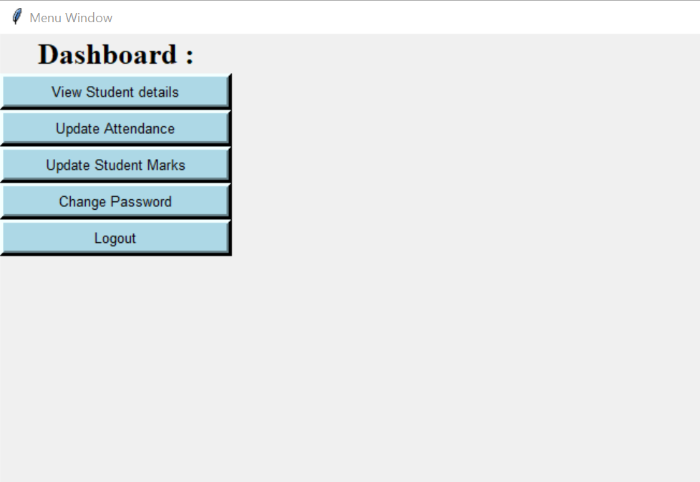
TEACHER MENU WINDOW:
Fig 6.24:Teacher Dashboard window

Slide 32
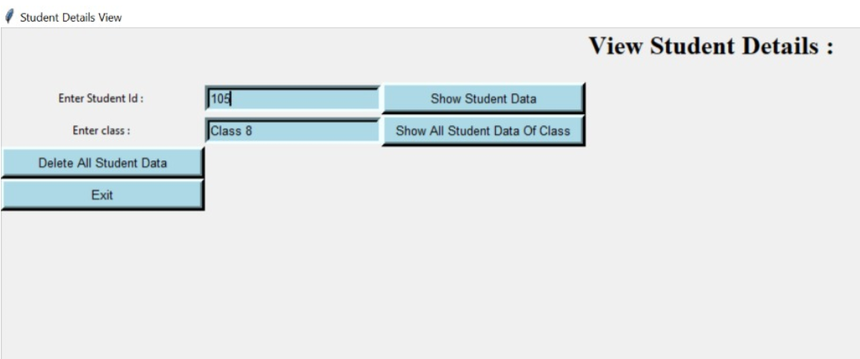
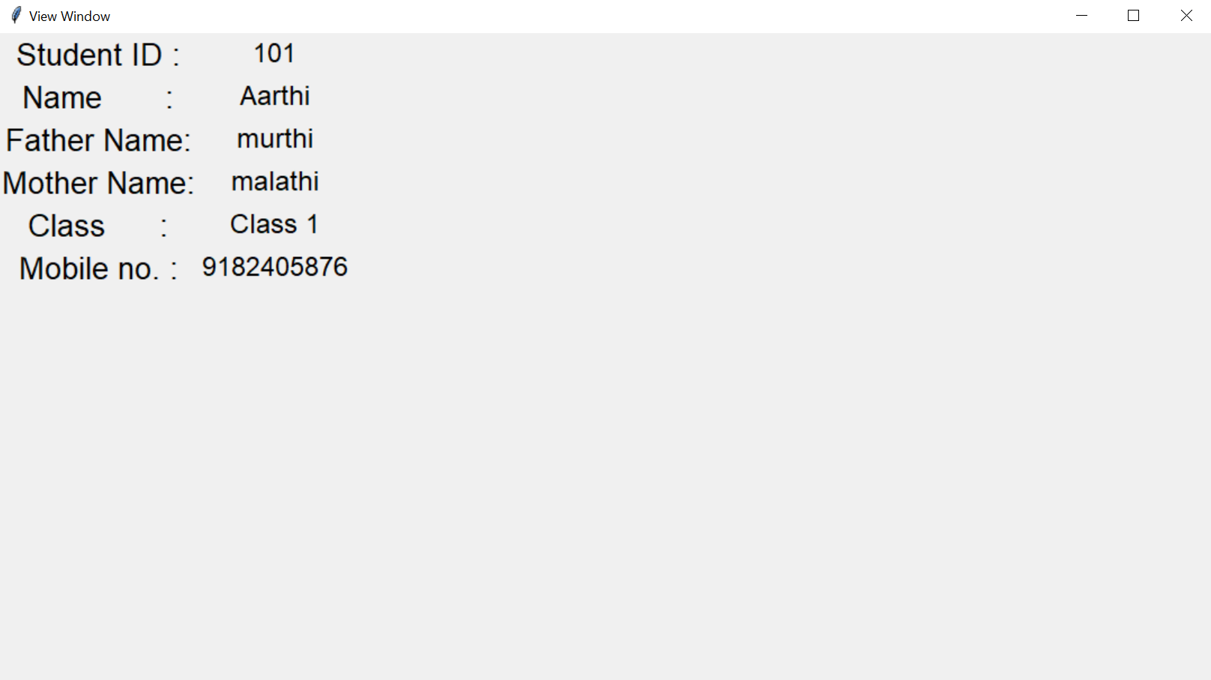
TEACHER: View Student Details
Fig 6.25:Teacher viewing student details
Fig 6.26:student details

Slide 33
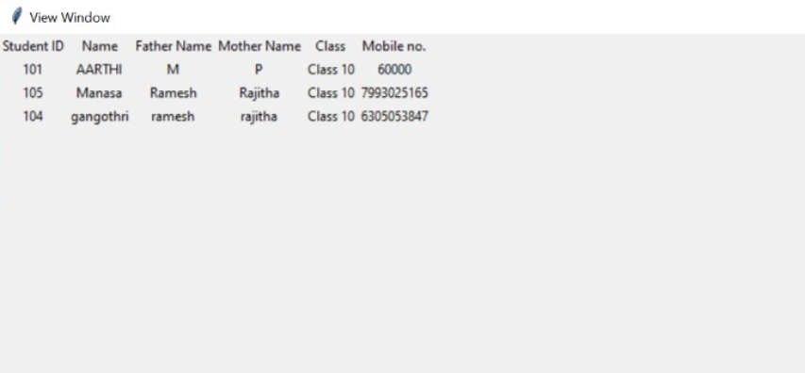
Fig 6.27:student details belonging to same class

Slide 34
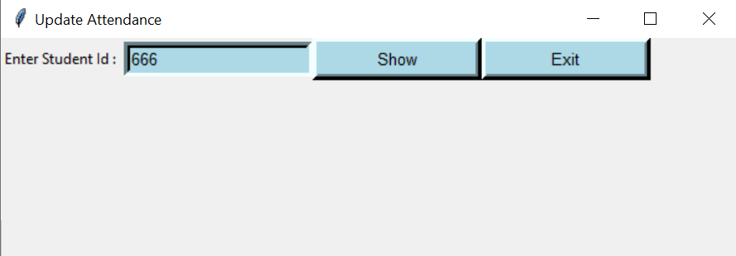
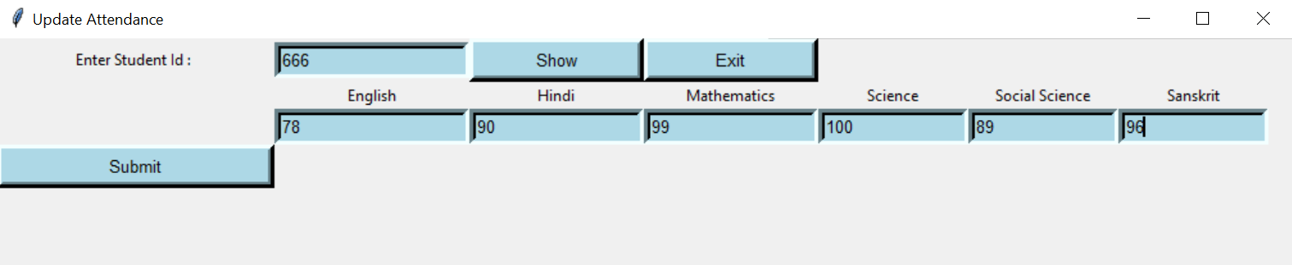
TEACHER: Update Student Attendance
Fig 6.28:Updating attendance
Fig 6.29:Entering attendance

Slide 35
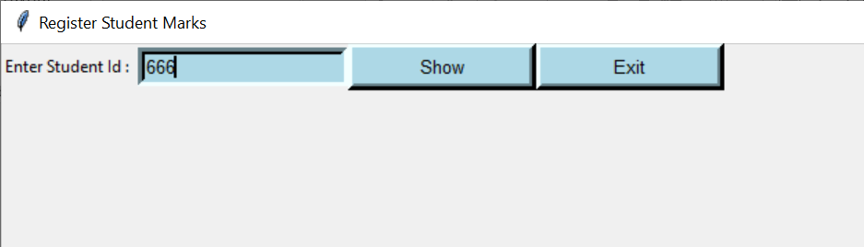
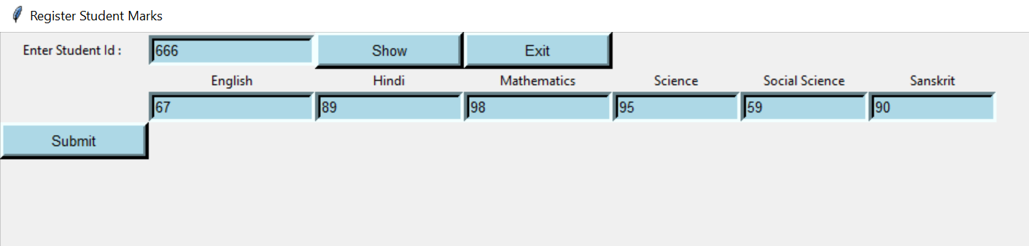
TEACHER: Update Student Marks
Fig 6.30:updating marks
Fig 6.31:Entering marks

Slide 36
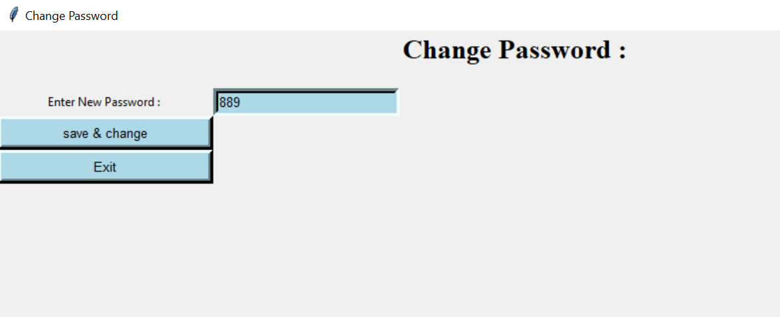
TEACHER: Change Password

Slide 37
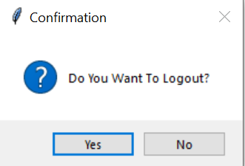
LOGOUT:
Fig 6.34:logout confirmation
message

Slide 38
CONCLUSION
In recent years, with the pace of technological development, people have become more and more demanding in terms of quality of life, and the schools managers in recent years look to improve a performance in their schools to get the highest rate of knowledge and experience in their student.
The school management system is bringing a great difference in the lives of students, teachers, parents, and the admin. Good management offers better productivity and hence more progress towards development . It helps the school to achieve the target, reduce work, increase efficiency, eliminating error, and monitoring progress.

Slide 39
FUTURE SCOPE
Some ideas and features can be considered as a future work for this project. These features can be summarized in the following points:
Let the student take exams Online, an online certification
Bank of questions per subject.
Let teacher add notes for the respective subject.
Let parent concatenation with other parents.
Let parent pay fee online

Slide 40
THANK YOU

